Slide 1
Lecture 2
Foreign Aid

Slide 2
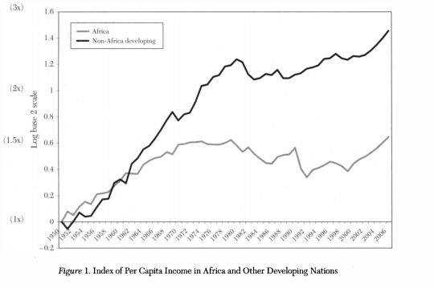
African Divergence
Africa's growth started diverging from the rest of the developing world in 60s
Divergence accelerated in the 70s when the African economy actually began to contract.
Life expectancy is 64
50.4 percent of Africa's population live below the extreme poverty line of$1.25 a day
Child Mortality: 78 deaths per 1,000 live births

Slide 3
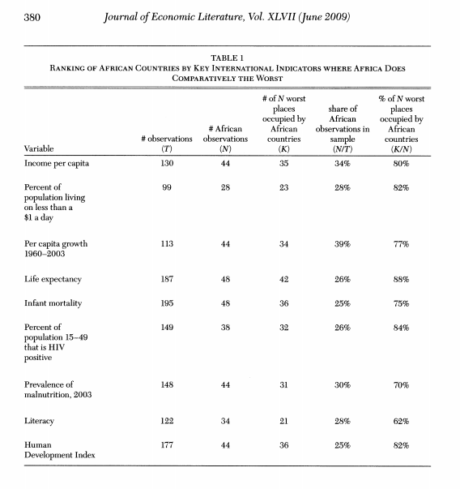
Poor Social Indicators

Slide 4
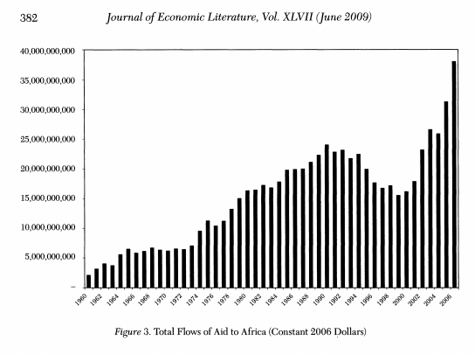
The Need to Save Africa
International Organization such as The GS, UN, and The World Bank have been dedicated to “saving Africa”.
UN Millennium Goals (cut poverty in half, universal education, reducing infant mortality,ect..).
Popular support as well (from Bono to Bill Gates).
Aid flows to have quadrupled since the late 60s.
Since the 60s a total of $714 billion in aid as been sent to Africa

Slide 5
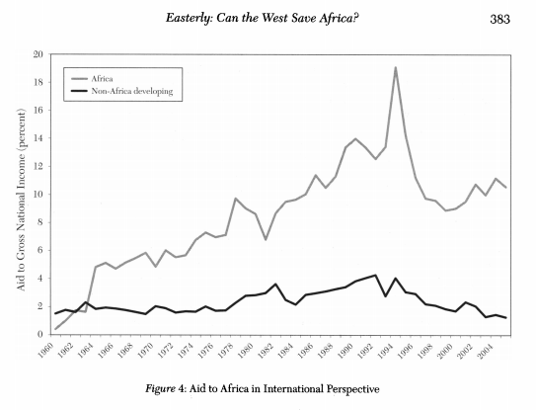
Aid Flows

Slide 6
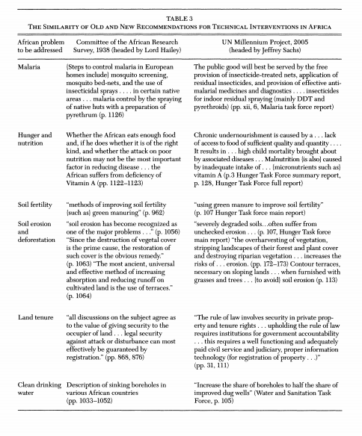
Not New

Slide 7
Development Ideas
Transformative Development: Attempts to fully transform Third World countries into developed economies.
Methods is by experts and planer drafting growth plains and having national governments implement them
Marginal Growth: Attempts to solve particularly severe problems in developing areas(clean water access and malaria) with no plans for structural transformation
Method is by empowering local entrepanuers and citizens to find solution the best alleviate the problems that aile them

Slide 8
Transformative Idea
The most popular idea amongst governments, NGOs, philanthropist, and the public at large.
Exemplified in programs such as the U.N Millennium Development Goals.
Has gone in and out of style from the 50s,70s, and 90s.
This recycling of the idea is due to the empirical literature routinely dampening the promises of these endeavors.

Slide 9
The Big Push
The Major strategy and theoretical backing for transformative Aid programs.
Originated from Albert Hirschman. Biggest proponent today is Jeffery Sachs.
Based around the idea of the Poverty Trap
Requires a massive amount of Aid to get a get third world country developing.

Slide 10
Poverty Trap
Theory: Typically if an economy is poor it should be able to achieve high growth rates. This is because in poor economies the Marginal(additional) units of capital are going to have a higher rate return then they would in developing areas. Thus developing areas should attract more investment which will raise their growth rates. This was the logic behind convergence theory
Trap: Some factor in the economy (Financial Markets, Property Rights, Government Accountability, Monetary Policy, Civil War, ect..) Is depressing the rate of return on capital. Thus necessary savings and investment aren’t being made to start growth because the rate of return is to low to justify the fixed costs.

